Slide 1
Revision 1
P3 Sem 1

Slide 2
A. Write the months.
一月 - _______________________
二月 - _______________________
三月 - _______________________
四月 - _______________________
五月 - _______________________
六月 - _______________________
January
February
March
April
May
June

Slide 3
B. Write the correct order of the months.
January → ___________________ → March
→ _______________→ __________________ → June
February
April
May

Slide 4
B. Write the correct order of the months.
_____________ ← February ← March
← _____________ ← May ← _____________
January
April
June

Slide 5
C. Write the opposites.
long - _________________
old - _________________
big - ________________
good - ________________
black - _______________
tall - ________________
short
young
small
bad
white
short

Slide 6
C. Write the opposites.
fat - _________________
strong - _________________
small - ________________
white - ________________
bad - _______________
young - ________________
thin
weak
big
black
good
old

Slide 7
D. Fill in the blanks with a / an.
__________ owl
__________ ice cream
__________ cake
__________ office
__________ cat
__________ apple
an
an
a
an
a
an

Slide 8
D. Fill in the blanks with a / an.
__________ rabbit
__________ axe
__________ island
__________ banana
__________ uncle
__________ ruler
a
an
an
a
an
a

Slide 9
E. Fill in the blanks with ’m / ’s / ’re .
I ________ a good student.
Benny _____ father a teacher. He _________ kind.
Miss Wong __________ skirt is blue.
They ___________ my friends.
Kelly _________ sister is good at English.
It ___________ my new pencil case.
’m
’s
’s
’s
’re
’s
’s

Slide 10
E. Fill in the blanks with ’m / ’s / ’re .
She _______ my mother. I love her.
Look at the birds! They __________ flying in the sky.
I __________ eight years old.
We _____ classmates. We study in Holy Family School.
You _________ a policeman. You _________ strong.
’s
’re
’m
’re
’re
’re

Slide 11
F. Answer the questions in complete sentences.
Are you a student?
__________, ___________________________
2. Is the boy reading now? (singing)
______, _____________. ______________________
3. Are the girls watching movie? (TV)
______,____________. ________________________
Yes
I am a student.
No
he isn’t
He is singing now.
No
they aren’t
They are watching TV.

Slide 12
F. Answer the questions in complete sentences.
4. Is it a pencil? (pen)
_________________________________________
5. How old are you?
_________________________________________
6. Where do you live?
_________________________________________
No, it isn’t.
It is a pen.
I am (eight) years old.
I live in Macau.

Slide 13
F. Answer the questions in complete sentences.
7. When do you go to school?
_________________________________________
8. How do you go to school?
_________________________________________
9. What do you do in autumn?
_________________________________________
I go to school at half past seven.
I go to school on foot/ by … .
I (fly kites/ go hiking/…) in autumn.

Slide 14
G. Fill in the blanks with Present Tense or Present Continuous Tense.
Please _____________ (close) the windows, Ally.
The boys _____________________(play) in the park at the moment.
Be careful! The bus ____________________(come).
Dad always ____________(work) at eight o’clock.
Let’s _____________ (draw) a picture now.
Tom __________ (live) in Macau.
She __________________ (not talk) at present.
close
are playing
is coming
works
draw
lives
is not talking

Slide 15
G. Fill in the blanks with Present Tense or Present Continuous Tense.
8. Don’t ____________ (walk) on the grass.
9. Mr. Lee ___________(teach) me English once a week.
10. ______ they ________ (drink) milk every night?
11. ______ the monkeys _________ (eat) apples now?
12. I often _________ (go) swimming with my sister.
She ____________ (like) swimming too.
13. Ken _____________(have) fish for lunch every day.
14. He _________________(not wash) his hair every night.
walk
teaches
Do
drink
Are
eating
go
likes
has
does not wash

Slide 16
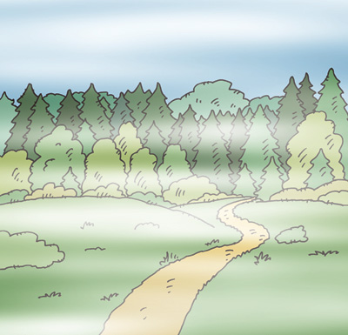
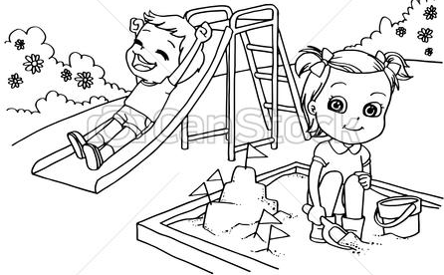
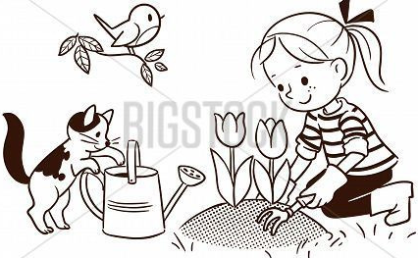
H. Look at the pictures and complete the conversations.
A: What’s the weather like in ________________?
B: It’s warm and ________________.
We go to the ___________ and plant ______________.
spring
foggy
park
flowers

Slide 17
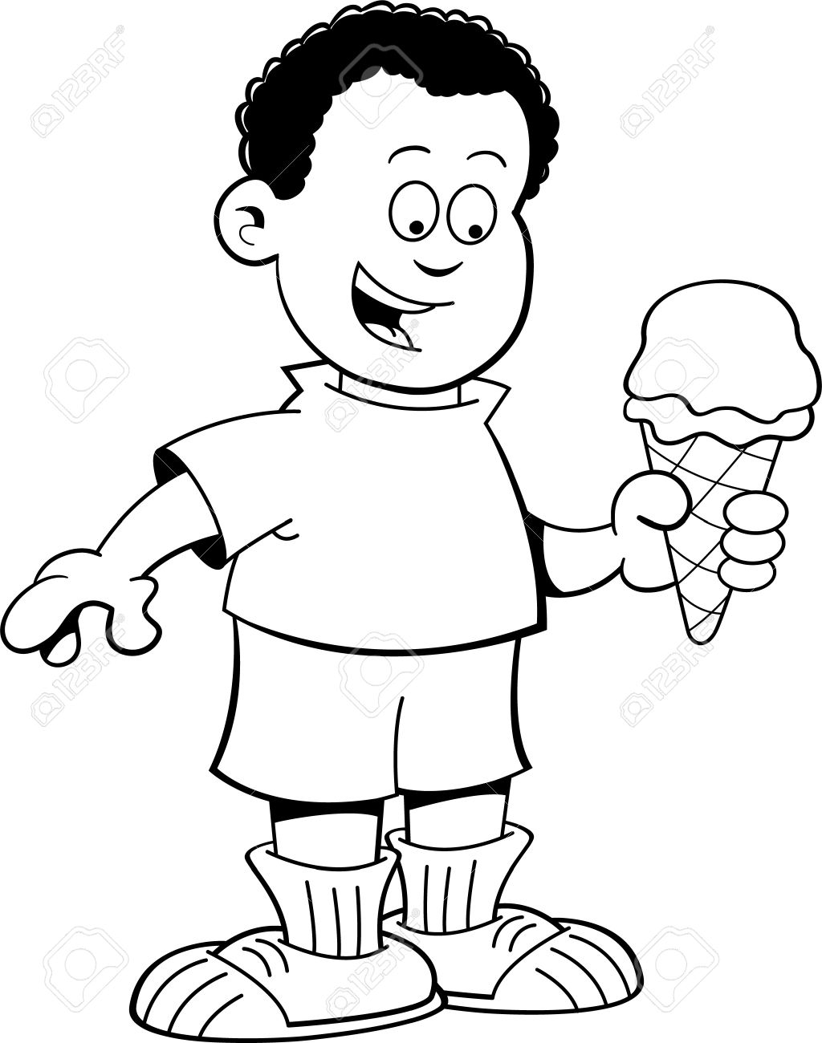
H. Look at the pictures and complete the conversations.
2. A: What’s the weather like in ________________?
B: It’s hot and ________________.
We go ________________ and eat ______________.
summer
sunny
swimming
ice cream

Slide 18
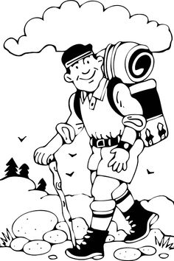
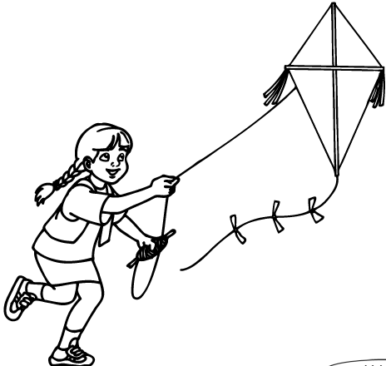
H. Look at the pictures and complete the conversations.
3. A: What’s the weather like in ________________?
B: It’s cool and ________________.
We go _______________ and fly ________________.
autumn
windy
hiking
kites

Slide 19
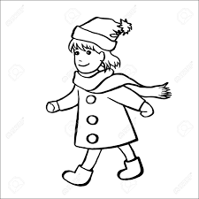
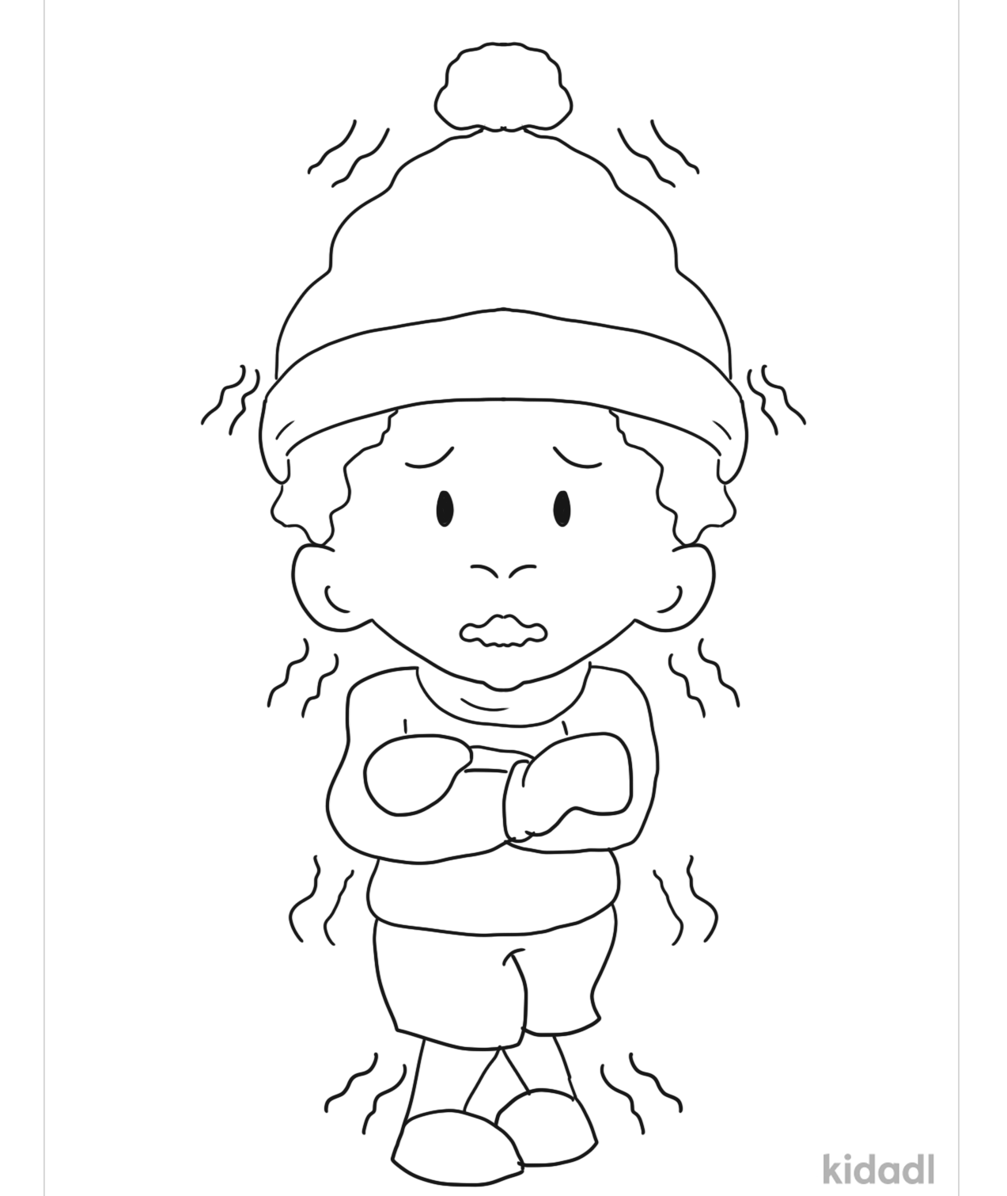
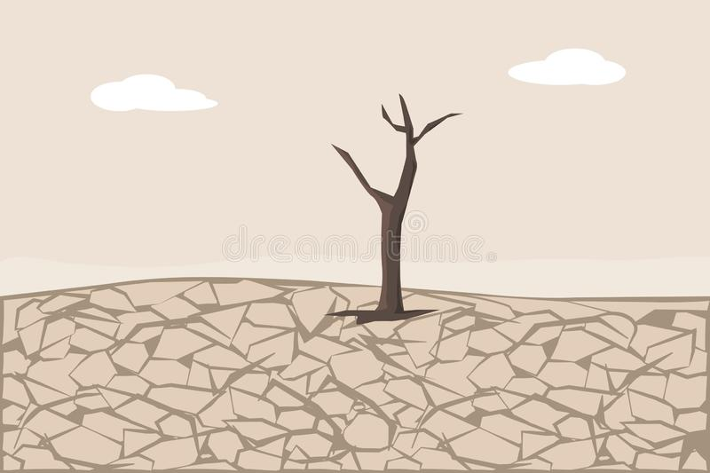
H. Look at the pictures and complete the conversations.
4. A: What’s the weather like in ________________?
B: It’s _________ and ________________.
We eat ______________ and wear a ______________.
winter
cold
dry
hotpot
scarf

